Slide 1

Data Breaches Affecting Washington State Residents
Guillermo Figueroa
BUS 798- Machine Learning and AI
Dr. Joshua E. Lambert

Slide 2

Literature Review
This study seeks to explore the impact of data breaches on Washingtonians, analyze the relationship between the number of affected individuals, consumer trust, and business revenue
Source:
(Data.wa.gov)September 2024

Slide 3

Problem Statement
The rise in data breaches threatens individual privacy and undermines public trust in businesses. However, despite the growing frequency of these incidents, there is limited research on the broader consequences of data breaches on consumer behavior, business and performance
Source:
(Data.wa.gov)September 2024

Slide 4

Objective
Evaluate how data breaches affects consumer trust in local businesses and revenue.
Source:
(Data.wa.gov)September 2024

Slide 5
Research Questions
RQ1: To what level the impact of data breaches on Washingtonians influence company revenues?
RQ2: Does the average days that takes to identify the breach impacts company revenues?
RQ3: Is there a statistical relationship between the frequency of data breaches notification and company revenues?

Slide 6
Hypothesis
H1: The number of Washingtonians impacted by the data breaches will affect the revenue of local entities
Null Hypothesis (Ho): There is no relationship between the number of Washingtonians impacted by data breaches and the revenue of local entities
Ho: The number of Washingtonians impacted by data breaches does not affect revenue.
Alternative Hypothesis (H₁): There is a significant relationship between the number of Washingtonians impacted by data breaches and the revenue of local entities.
H₁: The number of Washingtonians impacted by data breaches affect revenue
We fail to reject the null hypothesis as the p-value (>0.05)

Slide 7
Hypothesis
H2: The days that it takes to identify data breaches will affect consumer willingness to continue doing business with local companies
Null Hypothesis (Ho): The number of days it takes to identify data breaches has no effect on consumer willingness to continue doing business with local companies
Ho: The days taken to identify a breach do not affect consumer willingness
Alternative Hypothesis (H₁): The number of days it takes to identify data breaches has a significant effect on consumer willingness to continue doing business with local companies
H₁: The days taken to identify a breach affect consumer willingness
We fail to reject the null hypothesis as the p-value (>0.05)

Slide 8
Hypothesis
H3: The days elapsed before notification of data breaches will affect company reputation and revenue.
Null Hypothesis (Ho): The number of days before notification of data has no effect on company reputation and revenue
Ho: The days elapsed before notification of data breaches has a significant
Alternative Hypothesis (H1): The number of days before notification of data breaches has a significant effect on company reputation and revenue
H₁. The days elapsed before notification affect company reputation and revenue
We fail to reject the null hypothesis as the p-value (>0.05)

Slide 9
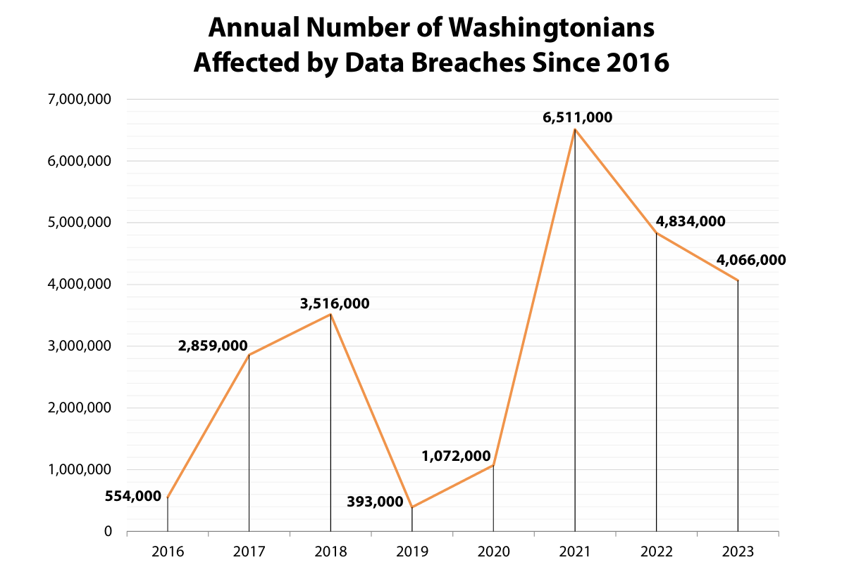
Number of Washingtonians Affected
Source:
(Data.wa.gov)September 2024

Slide 10
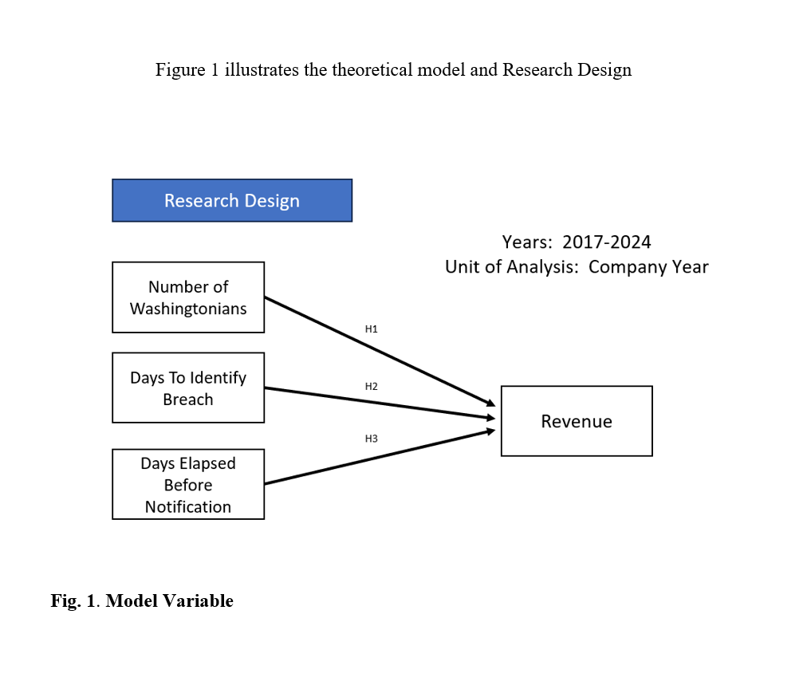
Methodology

Slide 11

Data & Methods
Data Sources:
Washington State Attorney General’s Office
Data.wa.gov
Dataset CSV File Format
Python
Machine Learning
Cross Validation
Sample Period
Methodology:
Empirical Analysis

Slide 12
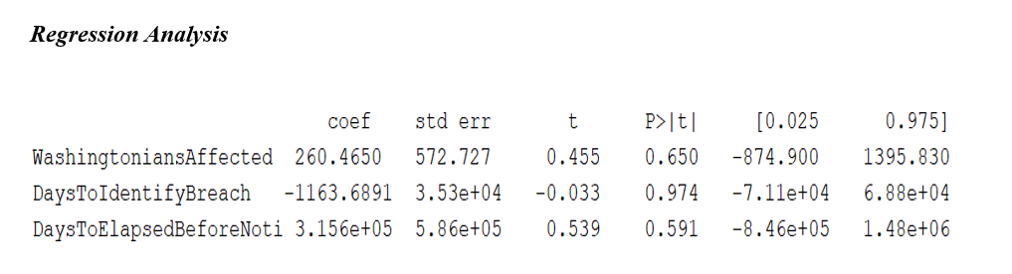
Results
The Predictor Variables do not show a statistically significant relationship with the dependent variable, as the p-values are (>0.05). We fail to reject the null hypothesis.

Slide 13
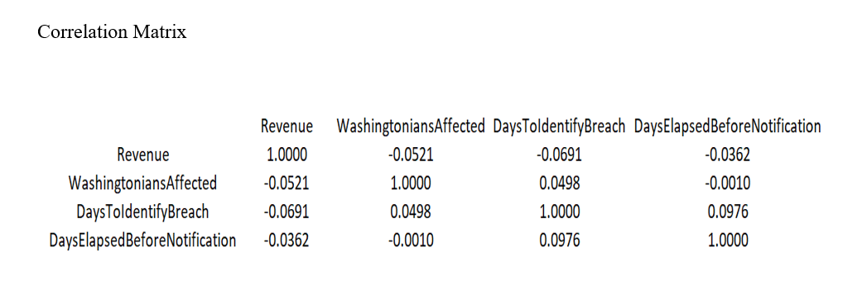
Results
The -0.521 correlation indicates that as the number of Washingtonians affected by a breach there is a slight tendency for the revenue to decrease. There is no linear relationship between the variables. The entities with higher revenues tend to take less time to identify breaches.

Slide 14
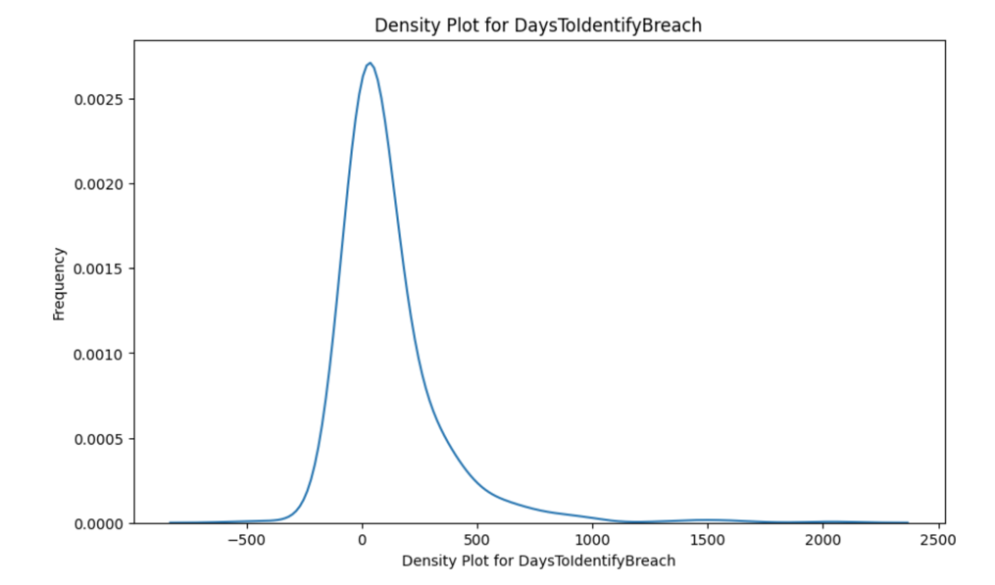
Results
The X-axis (Days to identify breach): This represents the number of days taken to notify residents after the breach.
Y-axis (Frequency): This indicates how often different values of days elapsed occur in the dataset. A higher density means that more breaches had a similar number of days to identify breach.

Slide 15
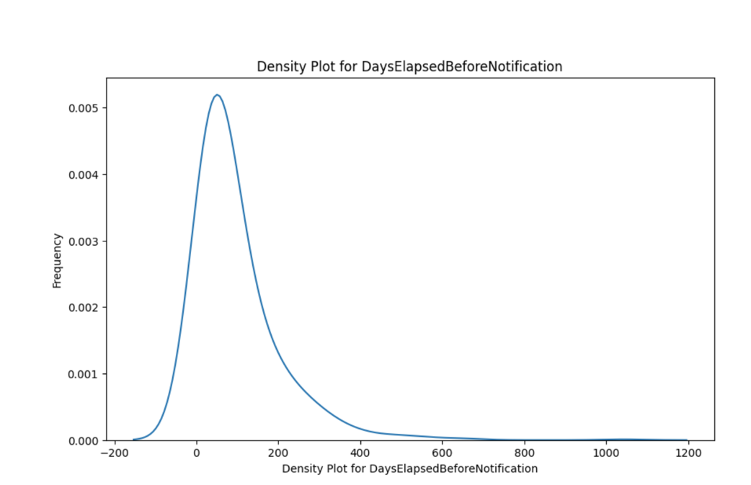
Results
The X-axis (Days Elapsed Before Notification): This represents the number of days taken to notify residents after the breach.
Y-axis (Frequency): This indicates how often different values of days elapsed occur in the dataset. A higher density means that more breaches had a similar number of days before notification.

Slide 16
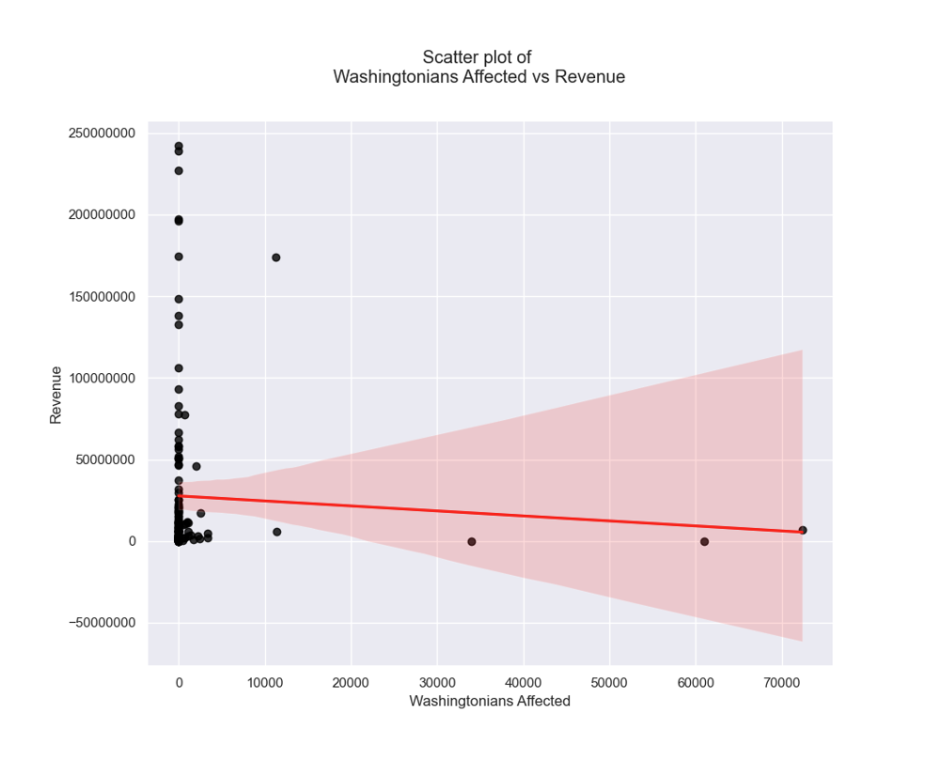
Results
There is no correlation on the volume of data breaches and company revenues

Slide 17
Conclusion
In conclusion there is no correlation, within the context of Washington, Corporate revenue and does not appear to be directly influenced by data breaches, even when accounting for the scale and impact of incidents. Factors such as the nature of the breach, customer loyalty, and strategies may drive the potential economic impact on company performance. Future research may consider exploring additional variables that can provide a significant relationship and predictable model.

Slide 18

Recommendations
Consider exploring additional variables and alternative predictors that might have a stronger relationship
Expand language access requirements for data breach notifications
Require more transparency from data collectors so Washingtonians know more about business that store and sell personal data
Improve cyber security training for employees and vendors

Slide 19

Q &A

Slide 20
Thank you!

